Slide 1
Time complexity

Slide 2
What is an algorithm?
An algorithm is a set of instructions, which are created to get the required output. Many different algorithms can give same output.
To perform these instructions a computer should have memory, and it also requires time to perform those actions.

Slide 3
What is Time Complexity?
The amount of time it takes to run the program and perform the functions in it is known as Time Complexity. By using Time Complexity we can determine whether the program is efficient or we have to use another algorithm which take less time compared to the other one.
Reducing Time Complexity of an algorithm is often difficult in Data Science, rather than difficult we can say its a bigger challenge.
We will tell the time complexity of a program by calculating the time taken to run the algorithm in the worst-case scenario.

Slide 4
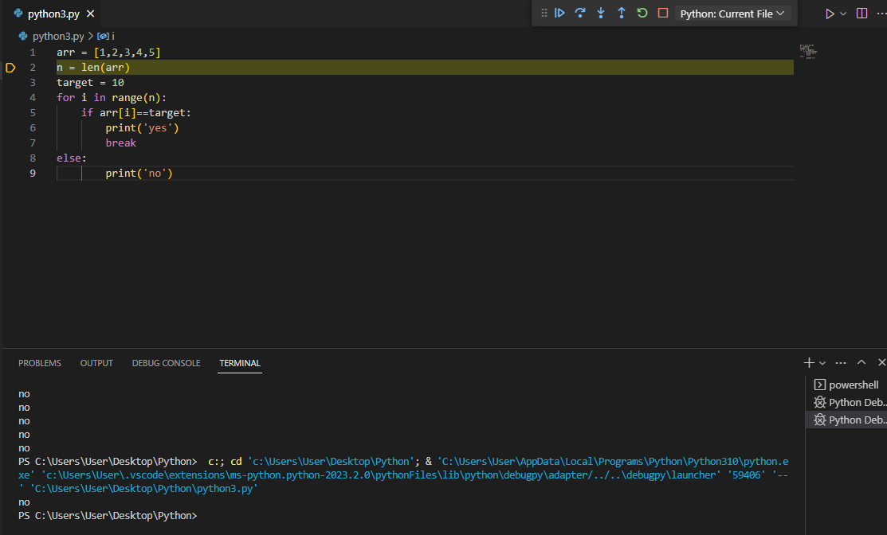
Let’s say we have a list which consists of integers and we have to check whether the number given by the user is present in that list or not.
arr = [1,2,3,4,5]
k = 10
The simple code for this is
Here, the worst-case for this algorithm is to check the number which is present in the last element of the given list. So, if we go by the above program, first it’ll start with index 0 and check whether that element in the list is equal to k or not, i.e, one operation and we have to check for every element in the list for worst-case scenario.

Slide 5
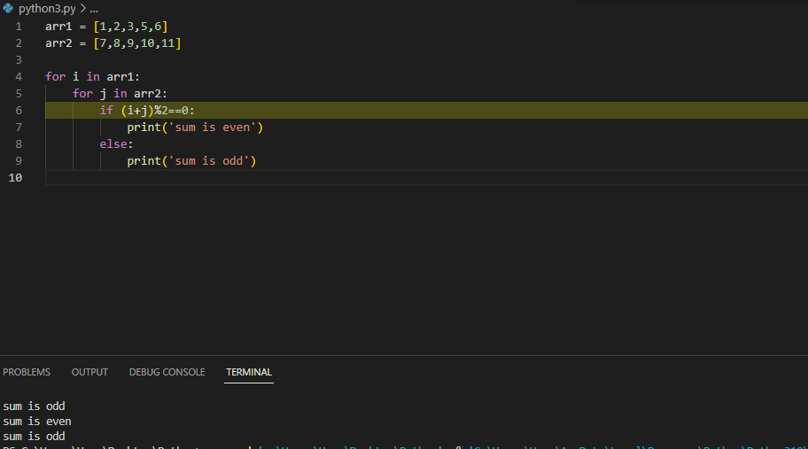
Given two lists of length ’n’ and check whether the sum of the elements in those two lists are even or odd.

Slide 6
Now, let see how we can determine the order for the above program in terms of n. Let’s assume, there are n elements in the given two lists. First for each value of i, j will have ’n’ elements to check for even or odd. Also, ‘i’ will have to run the loop for ’n’ elements.
So, there will be n*n operations needed to perform the above program. So the time complexity of above program is O(n²).
In Data Science, we often come across a large amount data and we need to search for particular entity or particular entry from that data. Reducing the time complexity in these type of programs will have huge impact in the real world.

Slide 7

Linear Search
Let’s see the example I stated above once again to understand the Linear Search.
We have a list which consists of integers and we have to check whether the number given by the user is present in that list or not.
A linear search is the most basic kind of search that is performed. A linear or sequential search, is done when you inspect each item in a list one by one from one end to the other to find a match for what you are searching for.
The Time Complexity of the above program is O(n).

Slide 8
A linear search is the most basic kind of search that is performed. A linear or sequential search, is done when you inspect each item in a list one by one from one end to the other to find a match for what you are searching for.
The Time Complexity of the above program is O(n).

